Slide 1
Protecting Addicted Youth
Angie Hamilton, Executive Director
Families for Addiction Recovery
Recovery Capital Conference, Toronto
September 13th, 2018

Slide 2
Scenario: What option would you choose?
Your 14-year-old son is addicted to cannabis. He sells it to fund his addiction. He doesn’t want treatment. Here are your options:
Have him arrested for trafficking
Force him to leave the house
Do nothing
Wouldn’t treatment, even if involuntary, be a better alternative?

Slide 3
Protecting Youth Seeking Treatment
Treatment
Private Treatment
Accessible
Publicly-funded
Timely
Compassionate
Evidence-based
Unregulated
Buyer beware

Slide 4
Protecting Youth Not Seeking Treatment
Barrier: Stigma
Public health approach
Decriminalization
Control and Regulation

Slide 5
Decriminalization
4 Reasons to Decriminalize
Drug Use is not Inherently Criminal
Prohibition is Harmful
Prohibition Doesn’t Work
Decriminalization Works

Slide 6
Substance Use Is Not Inherently Criminal
The primary purpose of criminal law is to protect people from other people, not to protect them from themselves.
There is nothing inherently criminal in consuming a substance or in self-harm. If there were, alcohol would be prohibited.

Slide 7
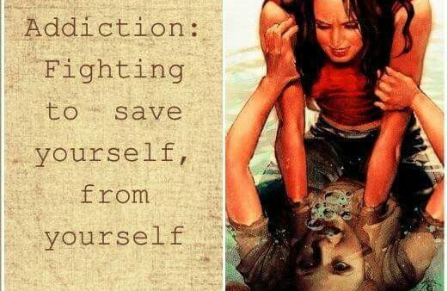
Addiction is self-harm

Slide 8
Criminalization is Harmful
Dependent Use
Non-Dependent Use
5% to 25%
75% to 95%

Slide 9
Prohibition Doesn’t Work
Prevalence of Illegal Drug Use in 2016:
More than 10% of Canadians aged 12 years or older (3.2 million Canadians)
More than 6% of youth aged 12-17
Source: 2016 Canadian Community Health Survey

Slide 10
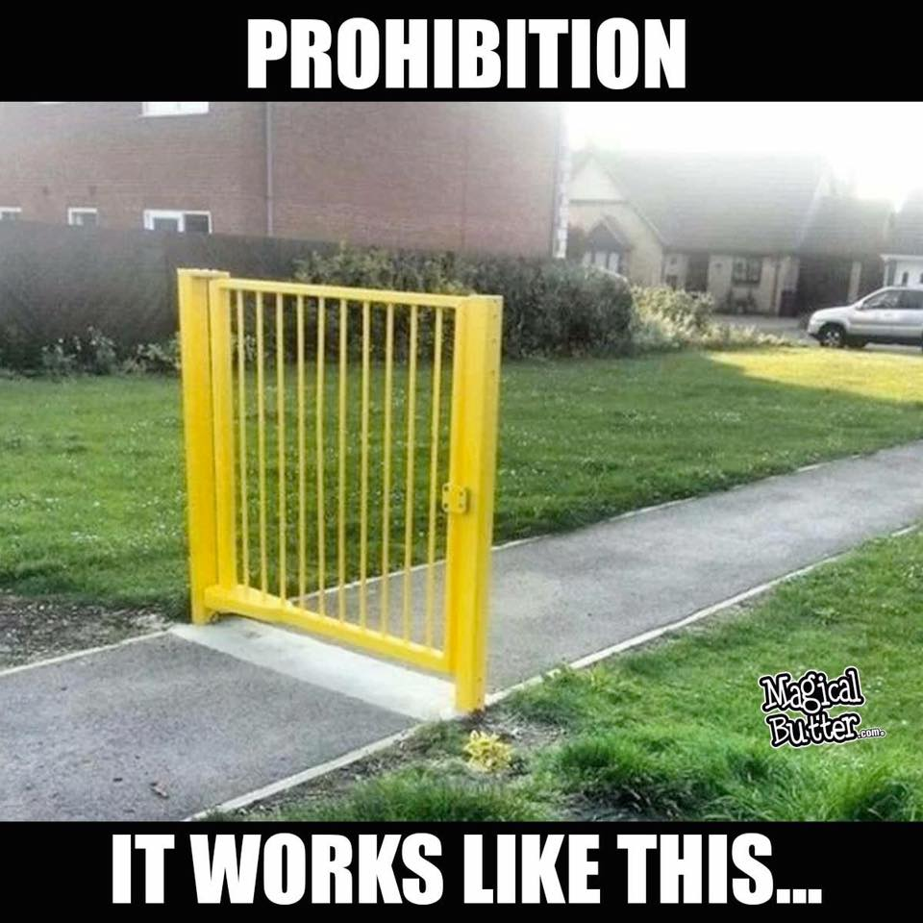
Prohibition Doesn’t Work

Slide 11
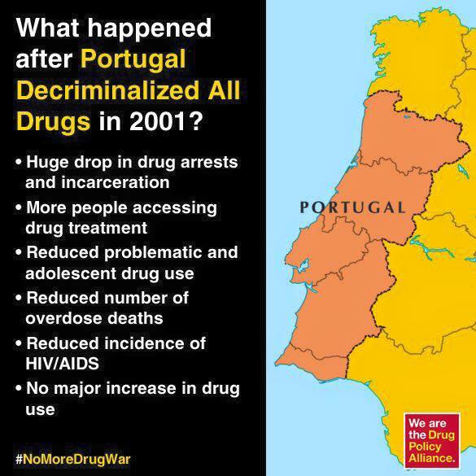
Decriminalization Works

Slide 12
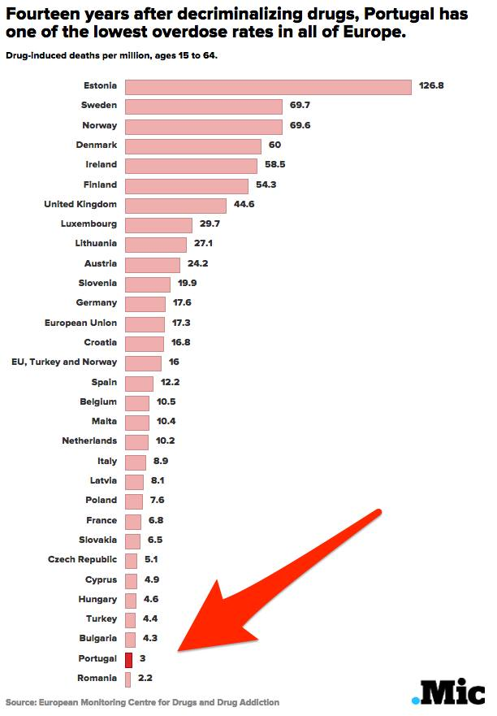
Decriminalization Works

Slide 13
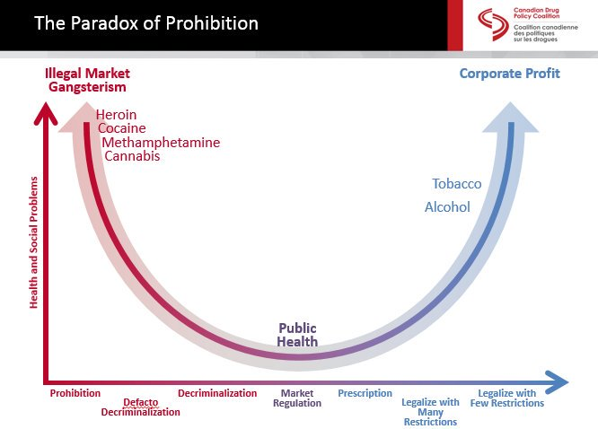
Regulation and Control

Slide 14
Barrier to Treatment: Lack of Insight
Youth (those 12-24 years old) with concurrent disorders often do not see their substance use as problematic. They might not access treatment because they want to handle their problems independently, are skeptical about treatment, or feel stigmatized accessing services.
Pathways to care for youth with concurrent mental health and substance use disorders, Ontario Center of Excellence for Child and Youth Mental Health (Watson, Carter and Manion, 2014)

Slide 15
Involuntary Treatment: A violation of rights?
1. Capacity
  The adolescent brain
  Effect of addiction on autonomy
2. Duty to Protect Vulnerable Children
3. UN Convention on the Rights of the Child (UN CRC)

Slide 16
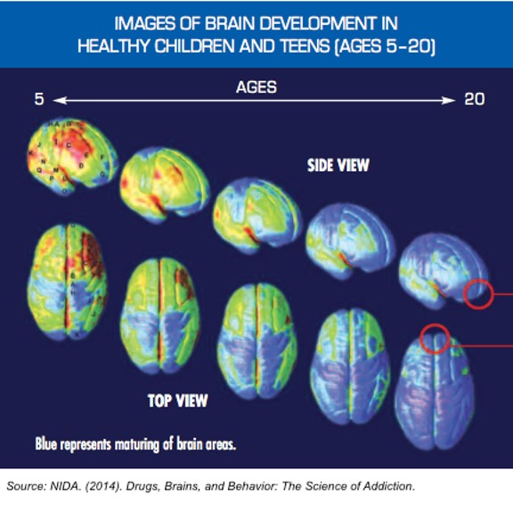
The Adolescent Brain
Prefrontal Cortex
Executive functions:
insight
decision making
judgement
planning
impulse control.

Slide 17
Addiction and Autonomy
“If we know anything about addiction at all, it is that it impairs autonomy in some way. Loss of control—in some manner and to some degree—over drug-seeking and consuming behavior is a defining feature of addiction, as it is popularly and scientifically conceived.”
(Levy, 2015)

Slide 18
Duty to Protect
“It is time to recognize that confinement for the purposes of merely “stabilizing” the child … is insufficient. Confinement must also serve the legitimate purpose of treatment. This will allow the system to better serve the long-term health of the child…”
Public Fatality Inquiry Report to the Minister of Justice and Solicitor General, The Honourable Judge Lloyd W Robertson into the death of MHC, 17 of Calgary, Alberta (2017)

Slide 19
UN Convention on the Rights of the Child (UN CRC)
Article 3: Best Interests of the Child
Article 24: Access to Health Care Facilities/Services
Article 33: Right to be protected from the use of illegal drugs and from being used in the drug trade

Slide 20
Report Findings/Suggestions
Putting the best interest of the child first would require significant changes in current models of formal health care
Need strategies to keep young people out of the criminal justice system
Codes of conduct by the colleges of health professionals on the best interests of the child.
Best Interests of the Child: Meaning and Implications in Canada, 2009

Slide 21
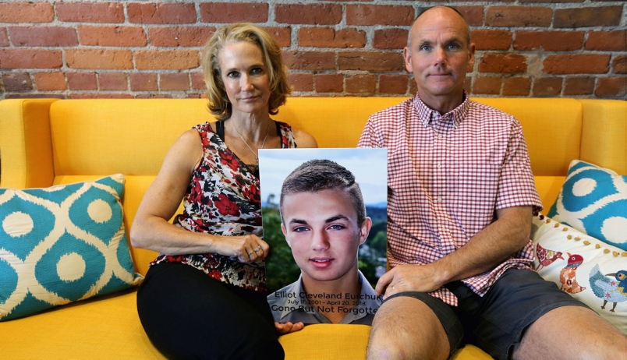
Rachel Staples and Brock Eurchuk
Their son Elliot, 16, died of an overdose in BC

Slide 22
When would involuntary treatment be appropriate?
    After less intrusive interventions have failed
    When it is in the best interest of the child

Slide 23
What happens if we continue to ignore this issue?
A (14, 13, 12?) year old walks in to a supervised injection site.
If young teenagers don’t want treatment and we do not intervene, they must have access to supervised injection sites, regardless of age.
What about a safe source of supply?

Slide 24
Involuntary Treatment
Unethical?
Ineffective?
Traumatic?

Slide 25
Analogy: suicide vs addiction to illegal substance
Suicide
Addiction to Illegal Substance
Your child is on a bridge
Your child is addicted to an illegal substance
(self-poisoning or Russian roulette)

Slide 26
Conclusion
We have a duty to protect addicted youth.
Accessible, publicly-funded, timely, compassionate, evidence-based treatment
Decriminalization, control and regulation of all drugs
Involuntary treatment must be a tool in the toolbox

Slide 27
www.farcanada.org
Angie Hamilton, Executive Director
angie@farcanada.org
Tel: (416) 559-5308
Toll free: (855) 377-6677

